Slide 1
OSI Reference Model
OSI Reference Model
1

Slide 2
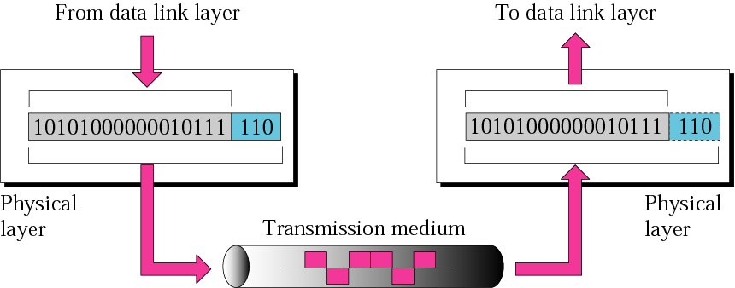
Physical Layer of OSI Model
The physical layer is responsible
for the movement of individual bits from one hop (node) to the next.

Slide 3
Physical Layer of OSI Model
The physical layer is concerned with the transmission of raw data bits over communication lines
Characteristics of the physical media that carry the signals and connectors which used for connecting the physical media
The physical layer accounts for much of the tangible components of a network, including cables and modems

Slide 4
Physical Layer of OSI Model
Defined on this layer:
Anything that can be used to transmit data is defined on the Physical layer of the OSI Model
Cable standards, wireless standards, radio frequencies and fiber optic standards
Data rate, Physical topology, and Transmission mode
Device example: Hub
Unit of measurement: Bits
4

Slide 5
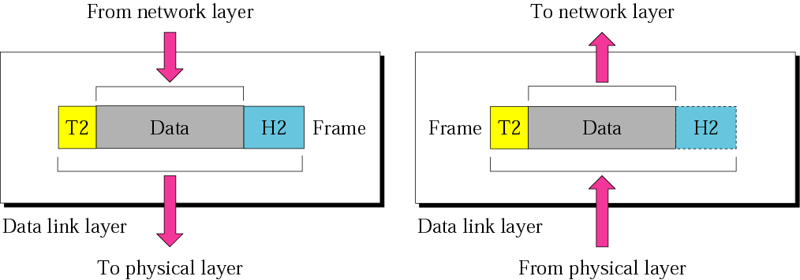
Data Link Layer of OSI Model
The data link layer is responsible for moving frames from one hop (node) to the next

Slide 6
Data Link Layer of OSI Model
Breaks the outgoing data into frames and re-assemble the received frames
Implement flow control and error control.
Requires MAC address or physical address
6

Slide 7
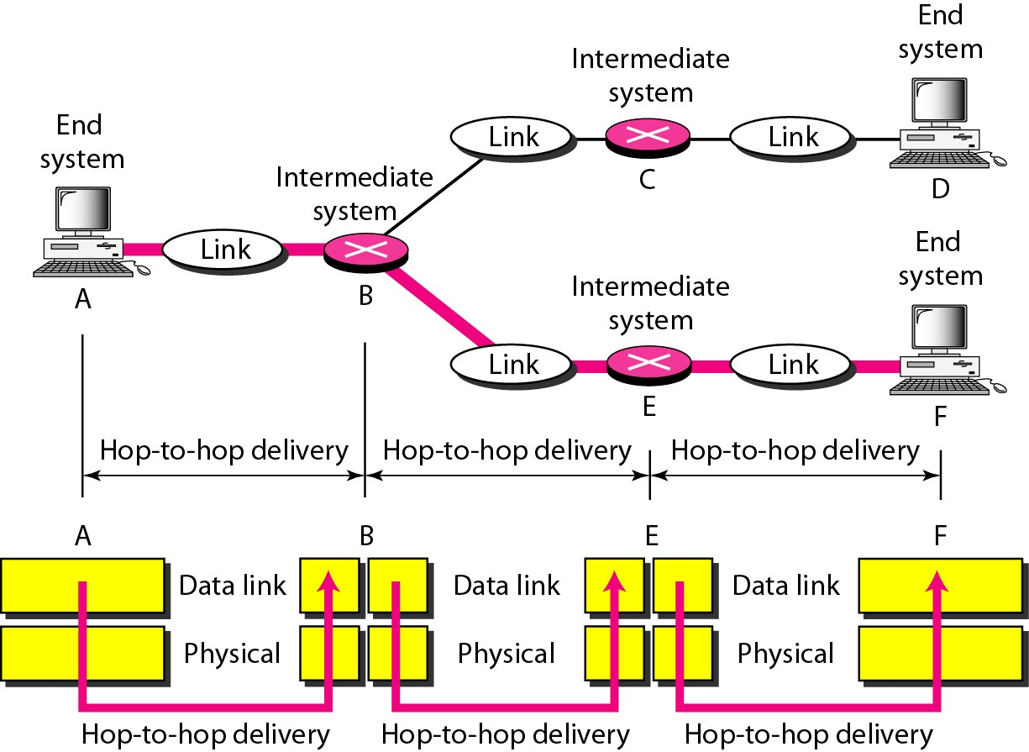
Hop-to-hop delivery

Slide 8
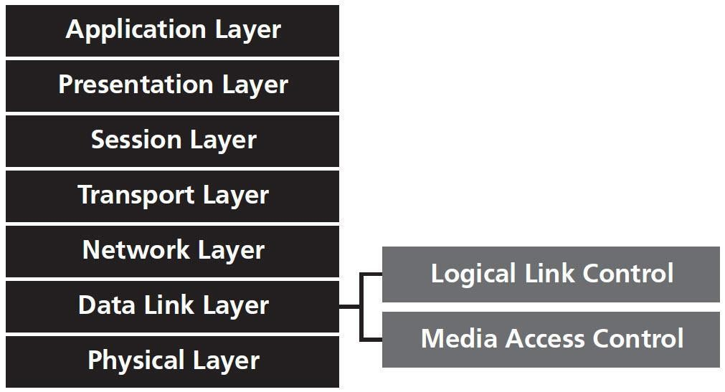
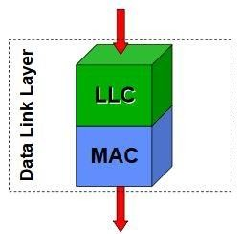
Data Link Layer of OSI Model
Unit of measurement: frames
Device example: Switch
Two sub layers: Logical Link Control (LLC) and the Media Access Control (MAC)
8

Slide 9
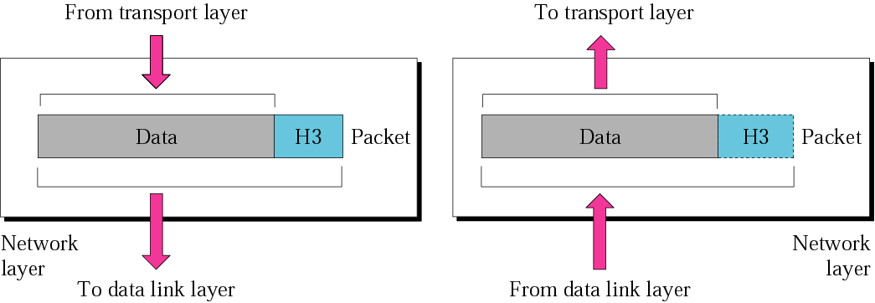
Network Layer of OSI Model
The network layer is responsible for the delivery of individual packets from the source host to the destination host

Slide 10
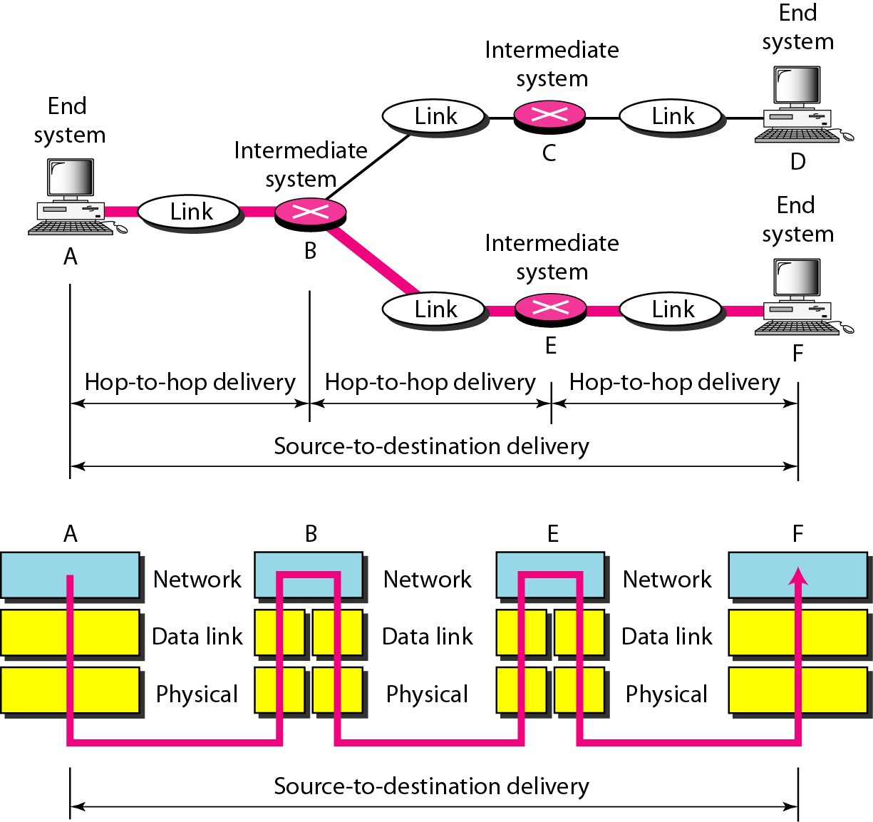
Source-to-destination delivery

Slide 11
Network Layer of OSI Model
Responsible for moving packets (data) from one end of the network to the other, called end-to-end communications
Requires logical addresses such as IP addresses
Source to destination error free delivery of packet
Unit of measurement: packets
Device example: Router
– Routing is the ability of various network devices and their related software to move data packets from source to destination
11

Slide 12
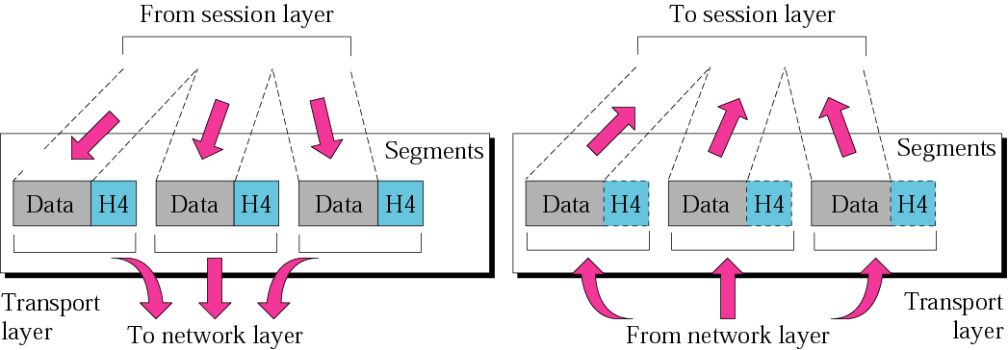
Transport Layer of OSI Model
The transport layer is responsible for the delivery of a message from one process to another

Slide 13
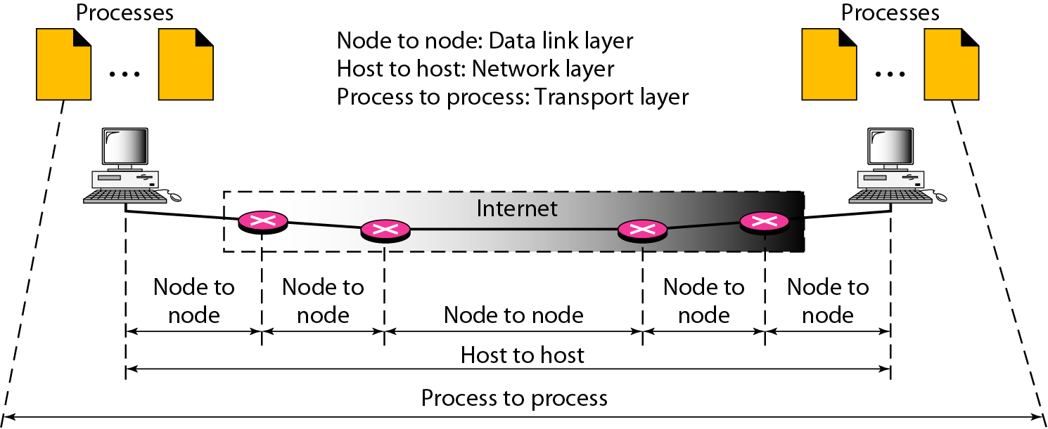
Process-to-Process Delivery of a Message

Slide 14
Transport Layer of OSI Model
Purpose of this layer is to provide a reliable mechanism for the exchange of data between two processes in different computers
Takes data from higher levels of OSI Model and breaks it into segments that can be sent to lower-level layers for data transmission
Uses port addressing
Unit of measurement used: segments

Slide 15
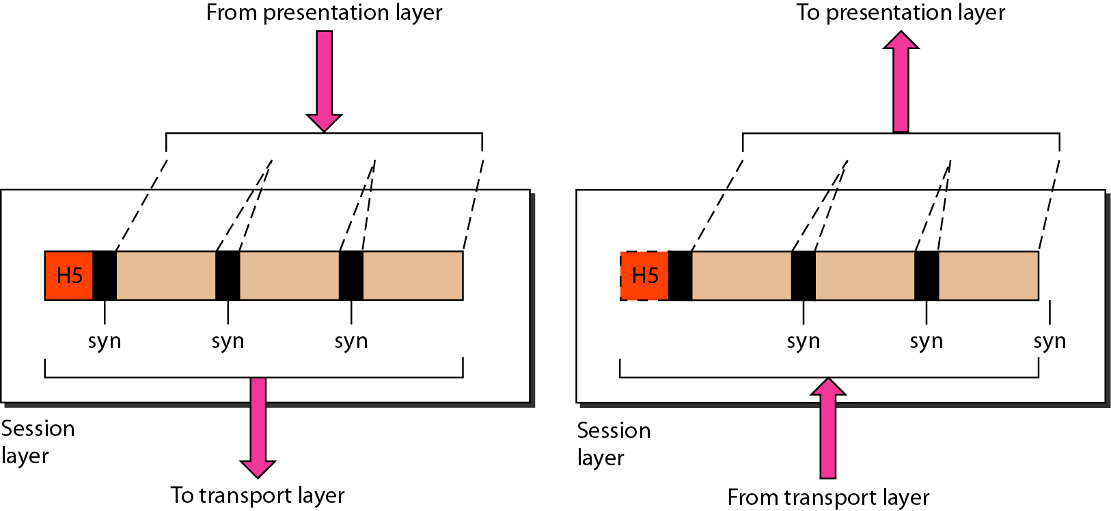
Session Layer of OSI Model
The session layer is responsible for dialog control and synchronization

Slide 16
Session Layer of OSI Model
Session layer provides mechanism for controlling the dialogue between the two end systems
It defines how to start, control and end conversations (called sessions) between applications
This layer requests for a logical connection to be established on an end-user’s request
Any necessary log-on or password validation is also handled by this layer

Slide 17
Session Layer of OSI Model
Synchronization
Synchronization on a network refers to ensuring that data or information across multiple devices or systems remains consistent and up-to-date in real-time.
Dialogue Control
Another function of this layer is Dialogue Control which determines whose turn is it to speak in a session.

Slide 18
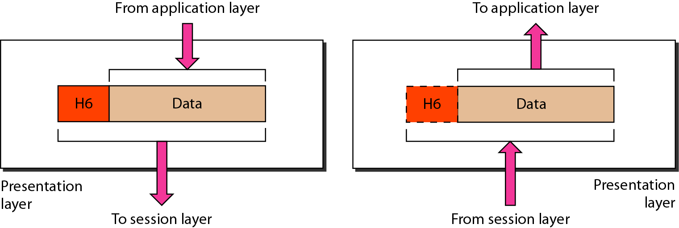
Presentation Layer of OSI Model
The presentation layer is responsible for translation, compression, and encryption

Slide 19
Presentation Layer of OSI Model
Presentation layer defines the format in which the data is to be exchanged between the two communicating entities
Common examples of these formats are
ASCII (American Standard Code for Information Interchange),
GIF (Graphics Interchange Format )
Handles three primary tasks:
Translation
Compression
Encryption
19

Slide 20
Presentation Layer of OSI Model
Translation
Presentation layer is responsible for converting various formats into required format of the recipient
Encryption
Data encryption and decryption is done by presentation layer for security
Compression and Decompression
Data to be transform compressed while sending and decompress while receiving for reducing time of transmission
20

Slide 21
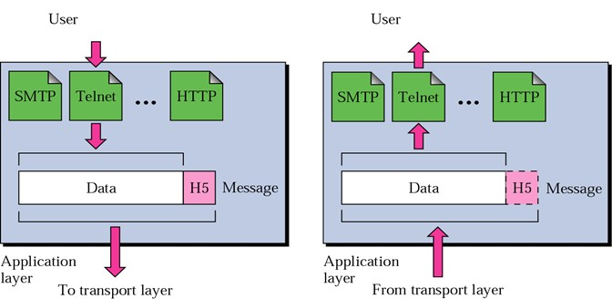
Application Layer of OSI Model
The application layer is responsible for providing services to the user

Slide 22
Application Layer of OSI Model
Application layer interacts with application programs and is the highest level of OSI model
Contains all services or protocols needed by application software or operating system to communicate on the network
22

Slide 23
Application Layer of OSI Model
Examples of application layer are applications such as
File transfer access and management
Mail services and directory services
Domain name to IP translation
Authentication
Remote login etc.
23

